Slide 1
Operating Systems Chapter 2: Process & Threads
Again:11-14.22-25.31.35-41
Liu Fagui

Slide 2
Content
Quick Quiz1
Review: Operating system structure
What is a process?
The Process Model
Process Creation & Process Termination
Process States
Implementation of Processes: Information in a process
Modeling Multiprogramming
What is a thread?
Thread Usage: Examples of using threads
The Classical Thread Model & POSIX Threads
Thread implementations
Pop-Up Threads
Making Single-Threaded Code Multithreaded
Summary

Slide 3
OS: A Friendly Deception
A simple extended machine
Manage resources
Drawback （缺点）? Maybe lots of extra work
Benefit（优势）: makes life easier for user

Slide 4
Users, Programs, Processes
Users have accounts on the system
Users launch programs
Many users may launch same program
One user may launch many instances of the same program
Processes: an executing program

Slide 5
Programs As Process Collections
Netscape (output of “ps x”)
7253 p0 S 0:19.26 /usr/local/lib/netscape/communicator-4.75.bin -irix-s
7280 p0 I 0:00.15 (dns helper) (communicator-4.7)
gcc (via “gcc –pipe –v”)
/usr/libexec/cpp |
/usr/libexec/cc1 |
/usr/libexec/as, followed by
/usr/libexec/elf/ld
ps(print status可查看process当前状态)

Slide 6
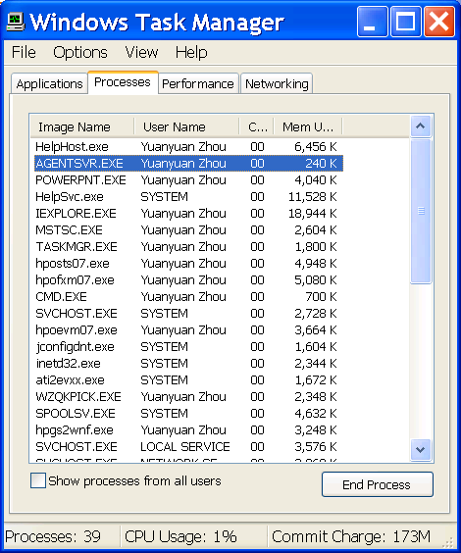
Windows Task Manager

Slide 7
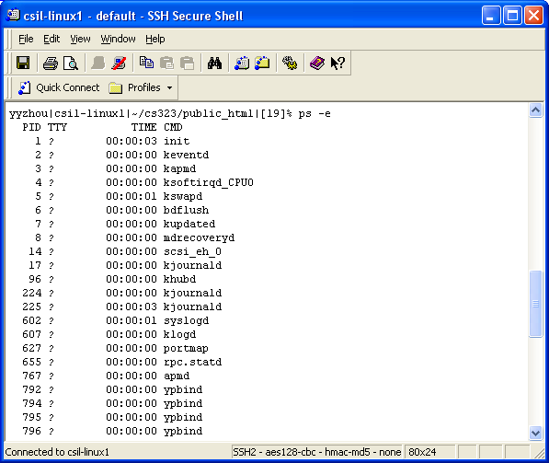
Unix Example: ps

Slide 8
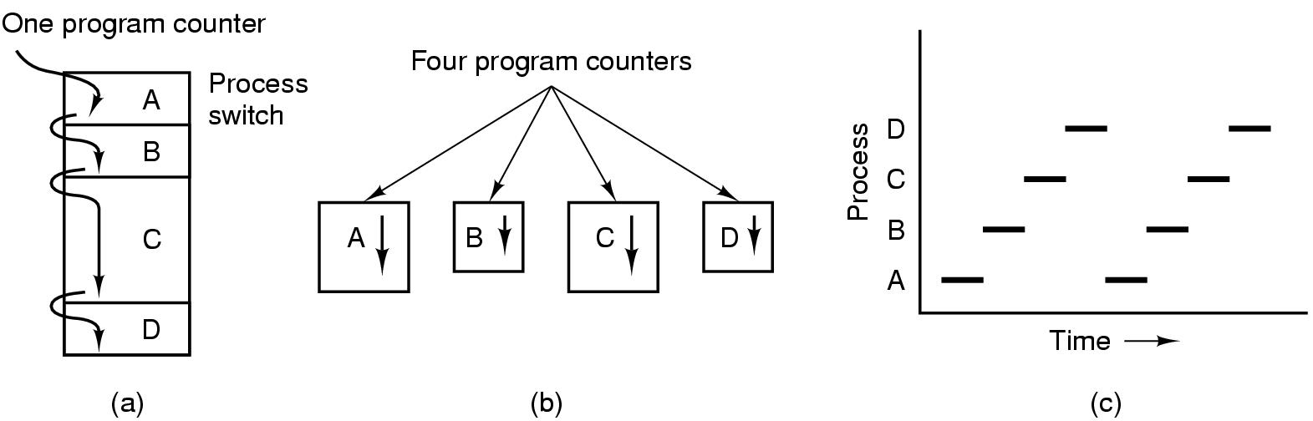
The Process Model
(a) Multiprogramming of four programs
(b) Conceptual model（概念模型） of 4 independent, sequential processes
(c) Only one program active at any instant
Real life analogy?
A daycare teacher of 4 infants

Slide 9
Process Creation
Events which cause process creation:
System initialization
reboot
Execution of a process creation system call
fork()
User request to create a new process
Command line or click an icon
Initiation of a batch job
cron
- cp bigfile newbigfile &（加&表示后台慢慢进行）

Slide 10
Process Termination
Events which cause process termination:
Normal exit (voluntary 自愿的)
End of main()
Error exit (voluntary)
exit(2)
Fatal error (involuntary非自愿)
Divide by 0, core dump
Killed by another process (involuntary)
Kill procID, end task

Slide 11
Process Hierarchies(层次)
Parent creates a child process, a child process can create its own processes
Forms a hierarchy
UNIX calls this a "process group“
UNIX:“init” root tree.
Windows has no concept of process hierarchy
all processes are created equal

Slide 12
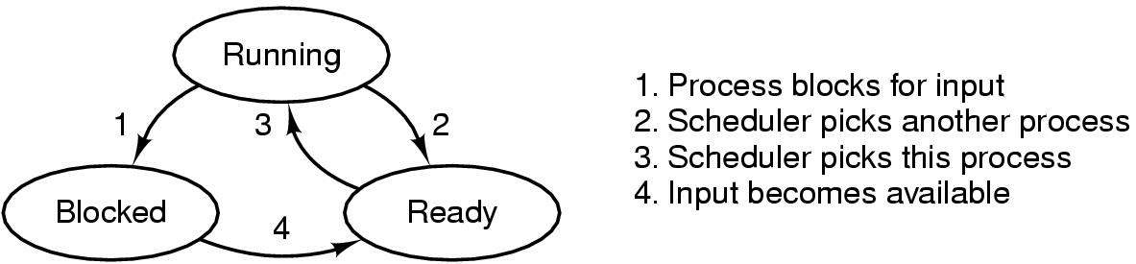
Process States
Possible process states
Running (occupy CPU)
Blocked
Ready (does not occupy CPU)
Other states: suspended, terminated
Transitions between states
Question: in a single processor machine, how many process can be in running state?
1

Slide 13
So What Is A Process?
It’s one executing instance of a “program”
It’s separate from other instances
It can start (“launch”) other processes
It can be launched by them

Slide 14
So What’s In A Process? And Why?
Process State
new, ready, running, waiting, halted;
Program Counter
the address of the next instruction to be executed for this process;
CPU Registers
index registers(变址寄存器), stack pointers, general purpose registers;
CPU Scheduling Information
process priority and pointer;
Memory Management Information
base/limit information;
Accounting Information
time limits, process number; owner
I/O Status Information
list of I/O devices allocated to the process;

Slide 15
What Does This Program Do?
int myval;
int main(int argc, char *argv[])
{ myval = atoi(argv[1]);
while (1)
printf(“myval is %d, loc 0x%lx\n”,
myval, (long) &myval);
}
Now simultaneously start two instances of this program
Myval 5
Myval 6
What will the outputs be?

Slide 16
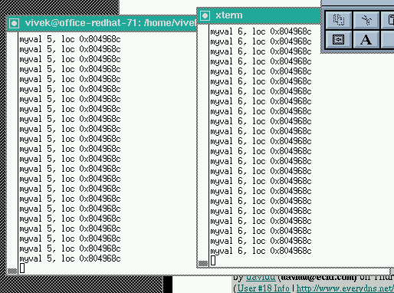
Here’s The Output

Slide 17
Instances Of Programs
The address was always the same
The values were different
Implies that the programs aren't seeing each other
But they think they’re using the same address
Conclusion: addresses are not absolute
Implication: memory mapping
What’s the benefit?

Slide 18
Remember This?
Application
Libraries
User space/level
Portable OS Layer
Kernel space/level
Machine-dependent layer

Slide 19
Address Space
One (common) approach
Kernel is high memory
User is low memory
What restrictions apply?
read(f, buf, nbytes)
0xffff….
Kernel space
User space
0x0000…

Slide 20
More Address Space
Program segments
Text
Data
Stack
Heap
What is stack?
What is heap?
What is data?
What is text?
0xffff….
Kernel space
User space
0x0000…

Slide 21
One Common Layout
Lots of flexibility
Allows stack growth
Allows heap growth
No predetermined division
0xffff….
Kernel space
Stack
Heap
Code & Data
0x0000…

Slide 22
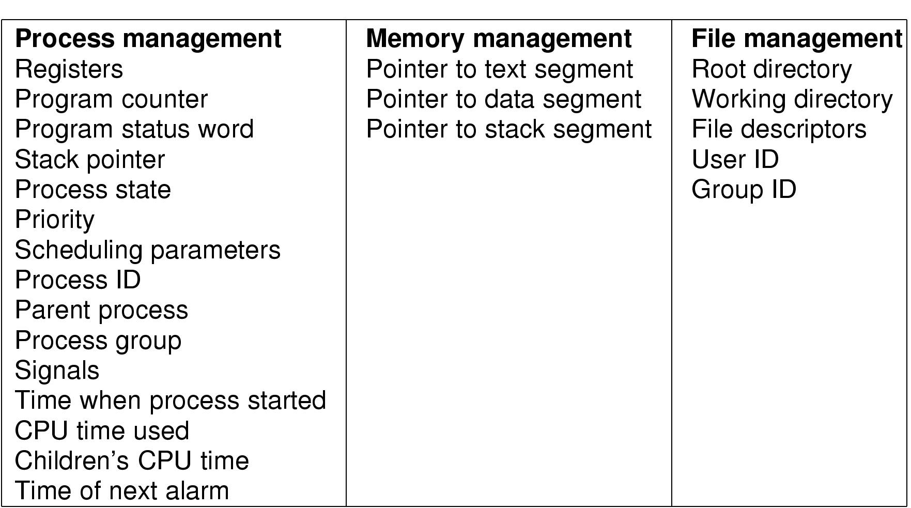
Implementation of Processes Process Control Block (PCB)
Fields of a process table entry

Slide 23
Context Switch
Switch CPU from one process to another
Performed by scheduler (chapter 2.4)
It includes:
save PCB state of the old process;
load PCB state of the new process;
Flush memory cache;
Change memory mapping (TLB);
Context switch is expensive(1-1000 microseconds)
No useful work is done (pure overhead)
Can become a bottleneck
Real life analogy?
Need hardware support

Slide 24
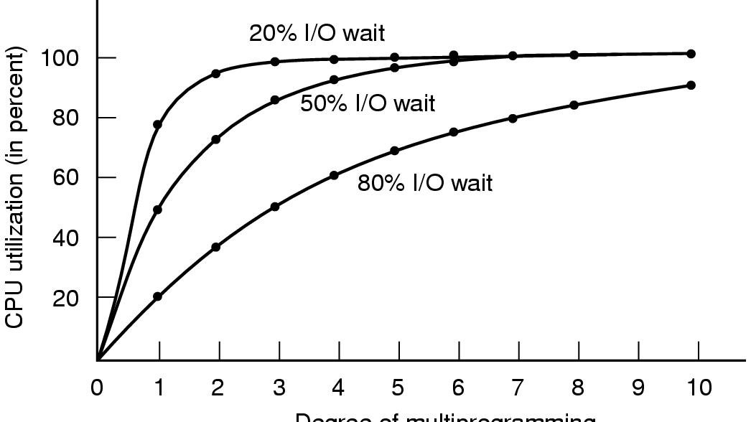
Modeling Multiprogramming
Figure 2-6. CPU utilization as a function of the number of processes in memory.(CPU利用率=1-P^{n}),其中p为一个进程等待I/O的时间与其停留在内存时间的比,n为同在内存的进程数)

Slide 25
Process Review
So What Is A Process?
It’s one executing instance of a “program”
It’s separate from other instances
It can start (“launch”) other processes
What’s in a process?
Code (text), data, stack, heap
Process control block
Process state, priority, accounting
Program counter, register variables, stack pointers, etc
Open files and devices

Slide 26
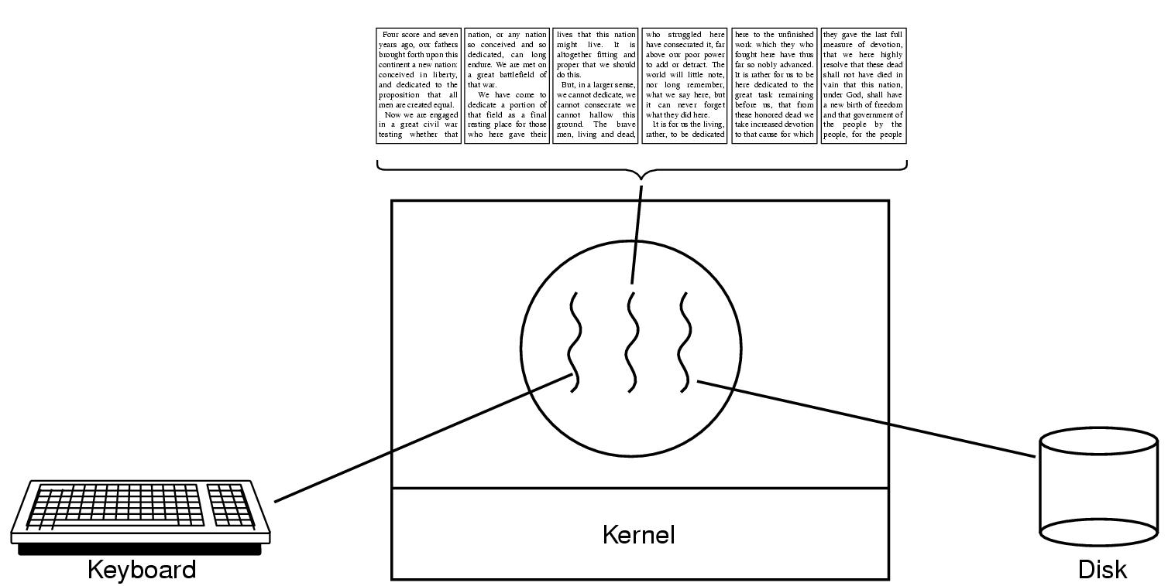
Thread Usage: word processor
Figure 2-7. A word processor with three threads.
What if it is single-threaded?

Slide 27
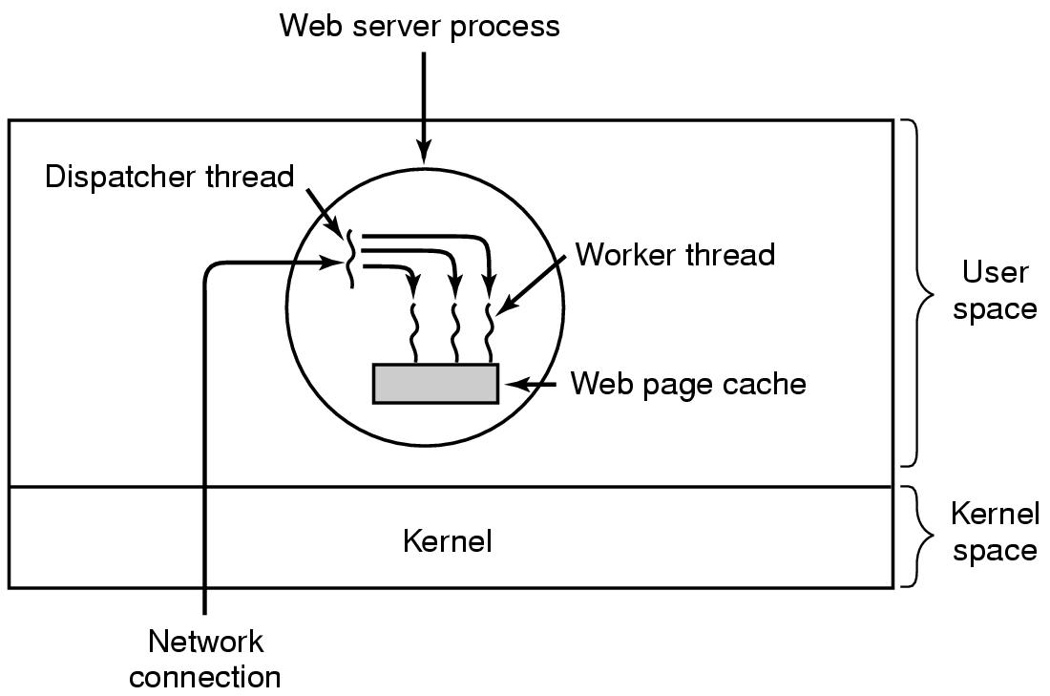
Thread Usage: Web Server
Figure 2-8. A multithreaded Web server.

Slide 28
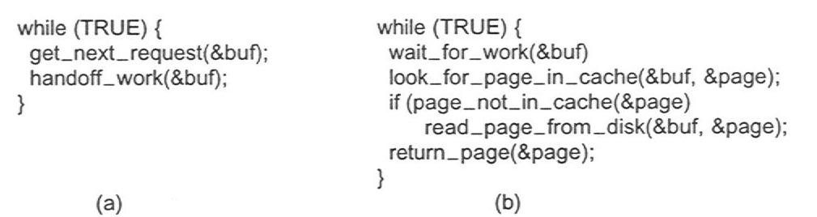
Web Server
Figure 2-9. Rough outline of code for Fig. 2-8.
(a) Dispatcher thread
(b) Worker thread

Slide 29
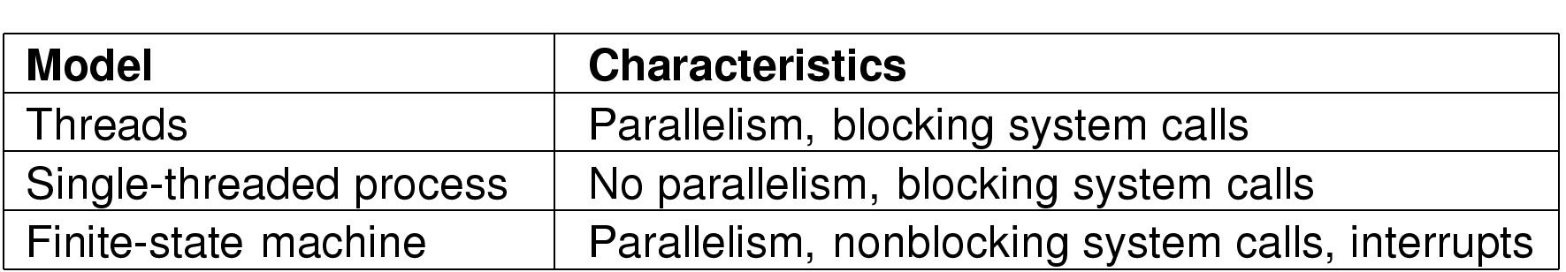
Tradeoffs
Three ways to construct a server

Slide 30
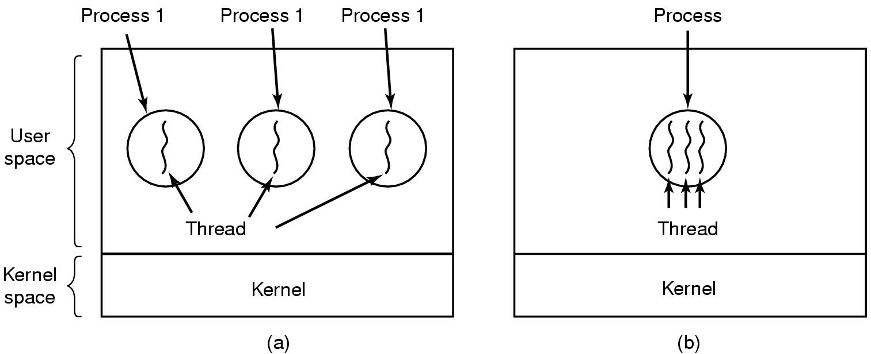
Threads: Lightweight Processes
Environment (resource)
execution
(a) Three processes each with one thread
(b) One process with three threads

Slide 31
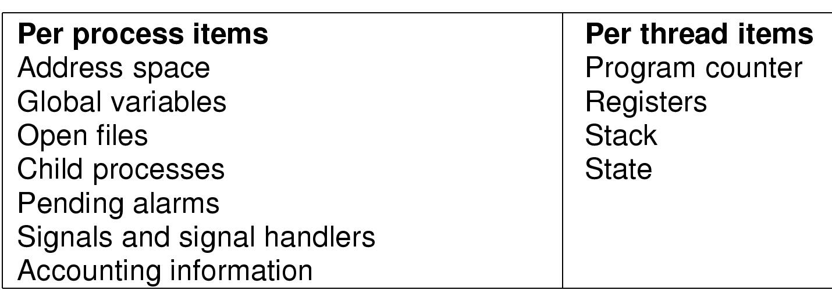
The Thread Model
Threads in the same process share resources
Each thread execute separately

Slide 32
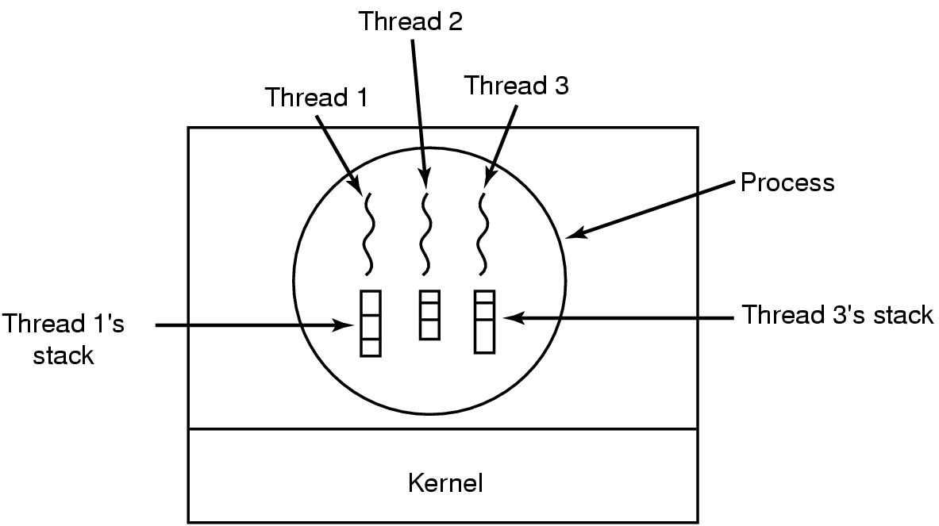
Why each thread has its own stack?

Slide 33
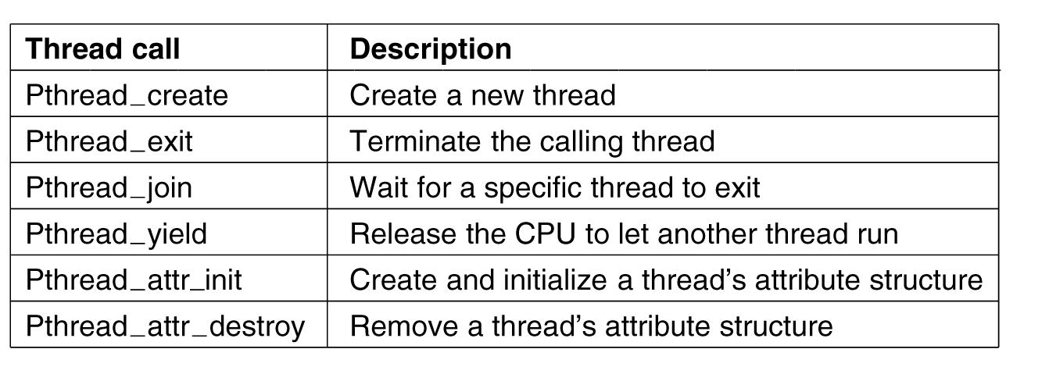
POSIX Threads (1)
IEEE标准1003.1c定义的线程包Pthread。
Figure 2-14. Some of the Pthreads function calls.

Slide 34
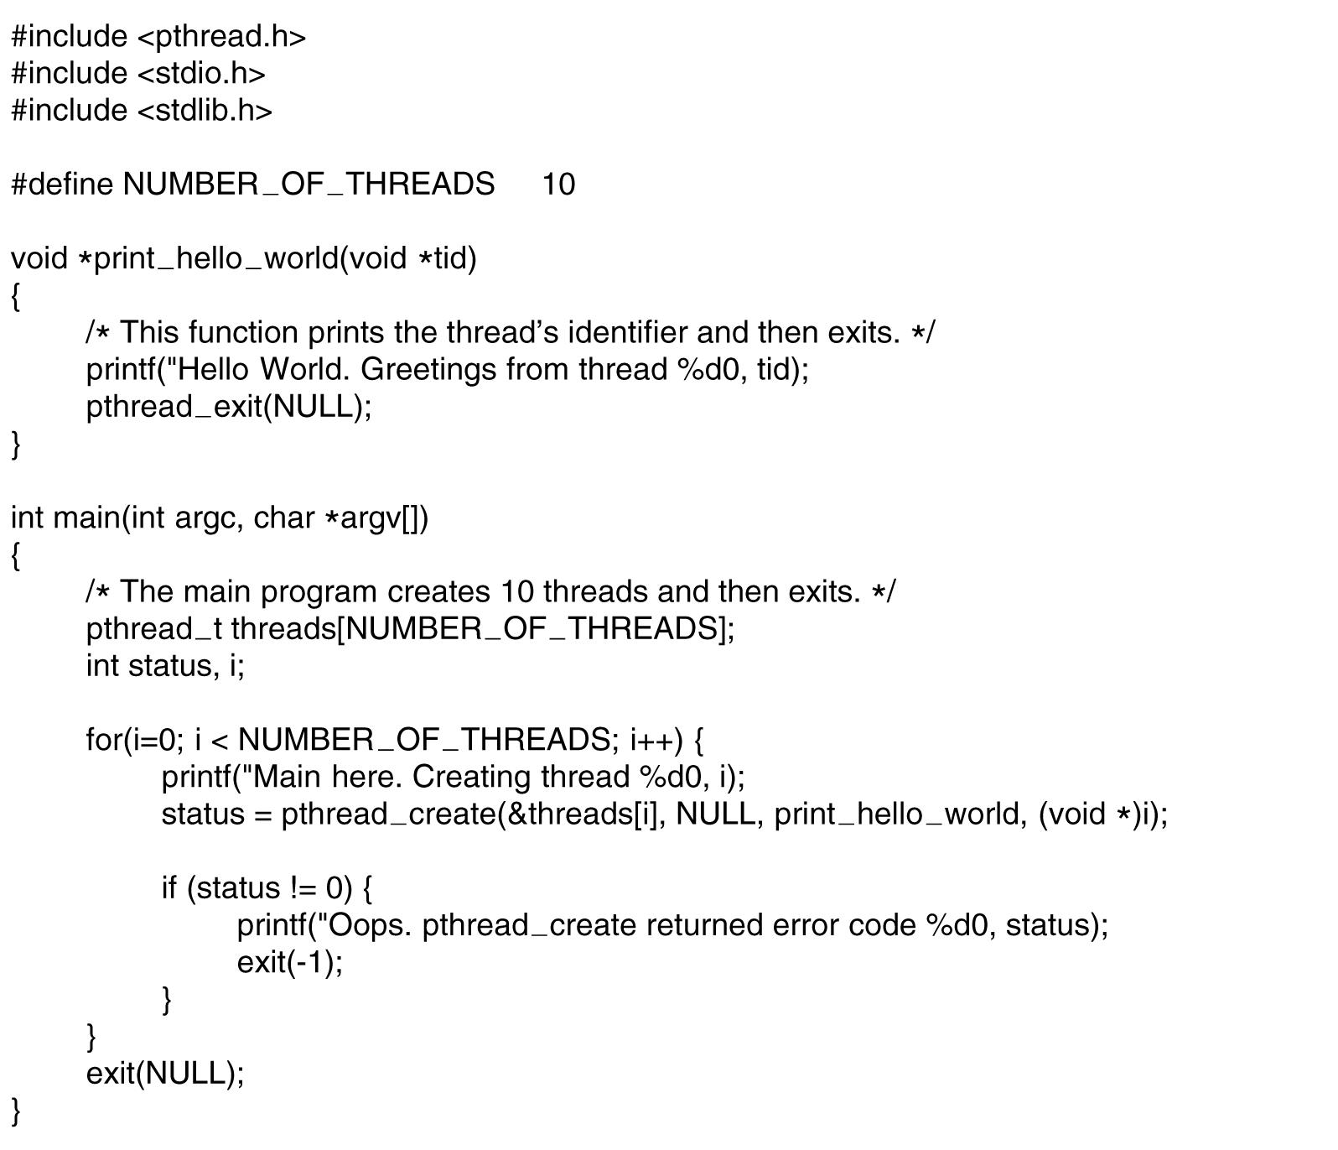
POSIX Threads (2)
. . .
Figure 2-15. An example program using threads.

Slide 35
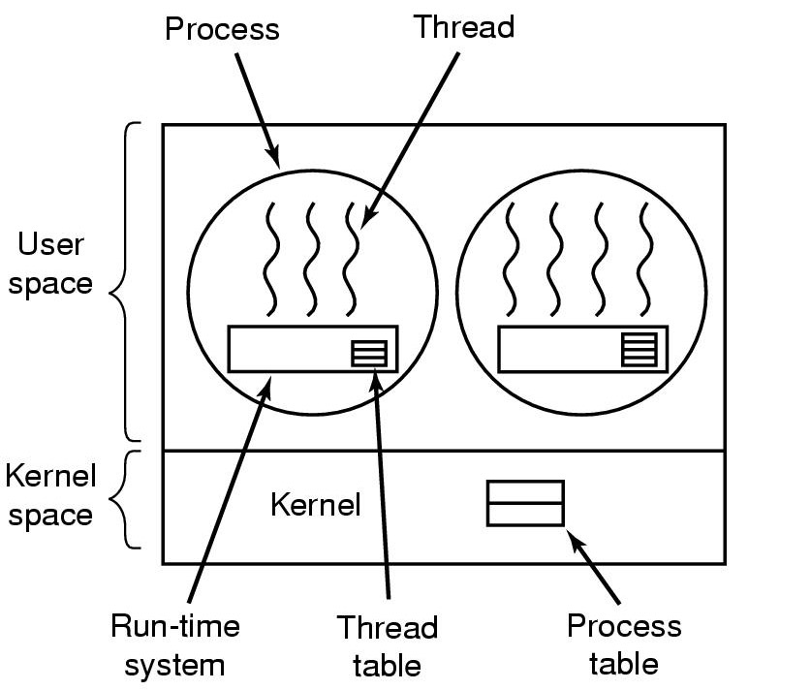
Implementing Threads in User Space (old Linux)
优点：
可以在不支持线程的操作系统上实现。可以通过函数库实现线程。
线程切换至少比陷入内核要快一个数量级。
允许每个进程有自己定制的调度算法
缺点：
需要运行时系统（是一个管理线程的过程的集合）支持。
每个进程需要其专用的线程表来跟踪进程中的线程。线程表由运行时系统管理
调度、阻塞都是对于整个进程的。
A user-level threads package
(整个线程包放在用户空间中，内核对线程一无所知）

Slide 36
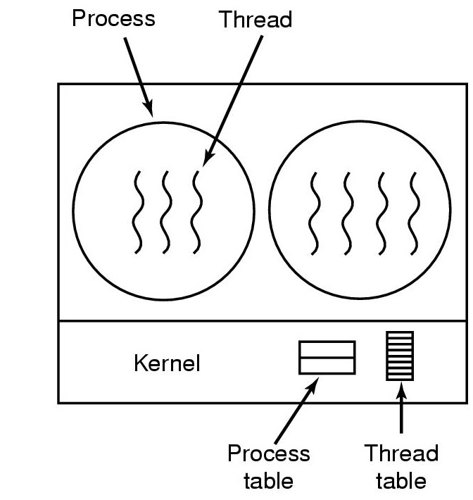
Implementing Threads in the Kernel (Windows 2000/XP)
优点：
不需要运行时系统支持。
每个进程没有线程表。内核有线程表
调度、阻塞都是对于线程的。不需要新的、非阻塞系统调用
缺点
线程切换需要陷入内核，慢。
A threads package managed by the kernel（内核管理线程）

Slide 37
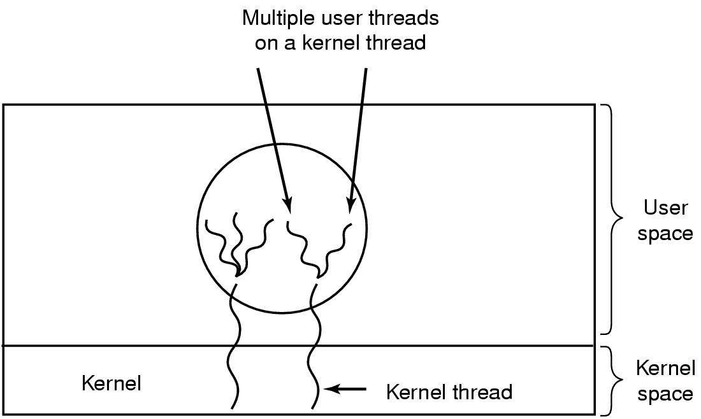
Hybrid Implementations (Solaris)
多个用户线程对应一个内核线程
Multiplexing user-level threads onto kernel- level threads (用户级线程与内核线程多路复用)试图结合用户级与内核级线程的优势
每个内核级线程有一个可以轮流使用的用户级线程集合

Slide 38
Scheduler Activations(调度程序激活) ----对于内核级线程改进其速度的方法
User-level
Goal – mimic(模仿) functionality of kernel threads
gain performance of user space threads
Avoids unnecessary user/kernel transitions
Kernel assigns virtual processors to each process
lets runtime system allocate threads to processors
Problem: Fundamental reliance （依赖 ） on kernel (lower layer)
calling procedures in user space (higher layer)
“upcall” （上行调用）
调度程序激活机制的一个目标是作为上行调用的信赖基础，违反分层系统内在结构的概念。

Slide 39
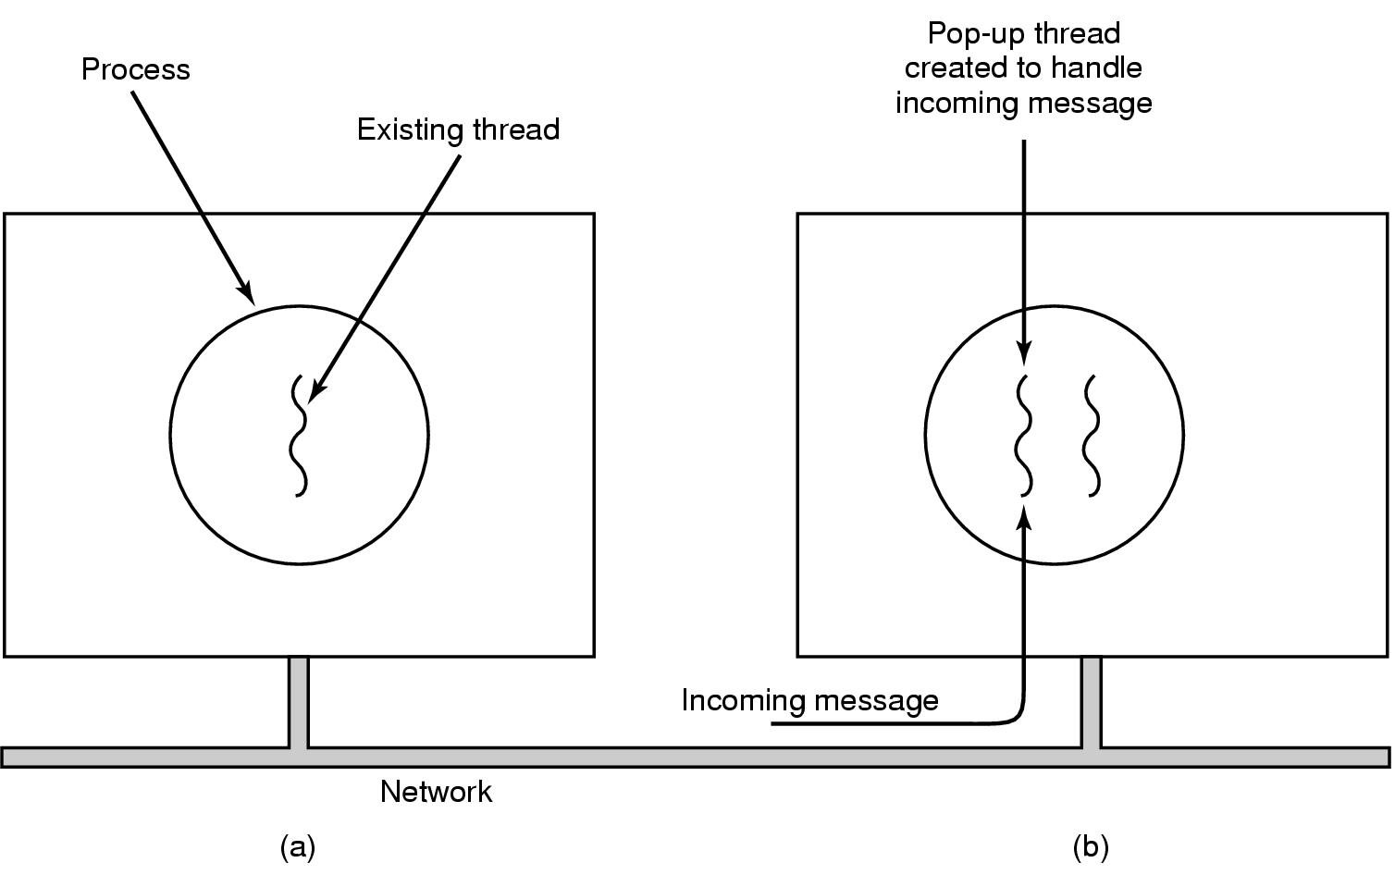
Pop-Up Threads ----分布式系统中另一种处理消息到来的方式
Creation of a new thread when message arrives
before message arrives (b) after message arrives
效果:由于快速创建,消息到达与处理之间的时间非常短
使用弹出式线程，是在内核空间还是用户空间运行需要提前计划。

Slide 40
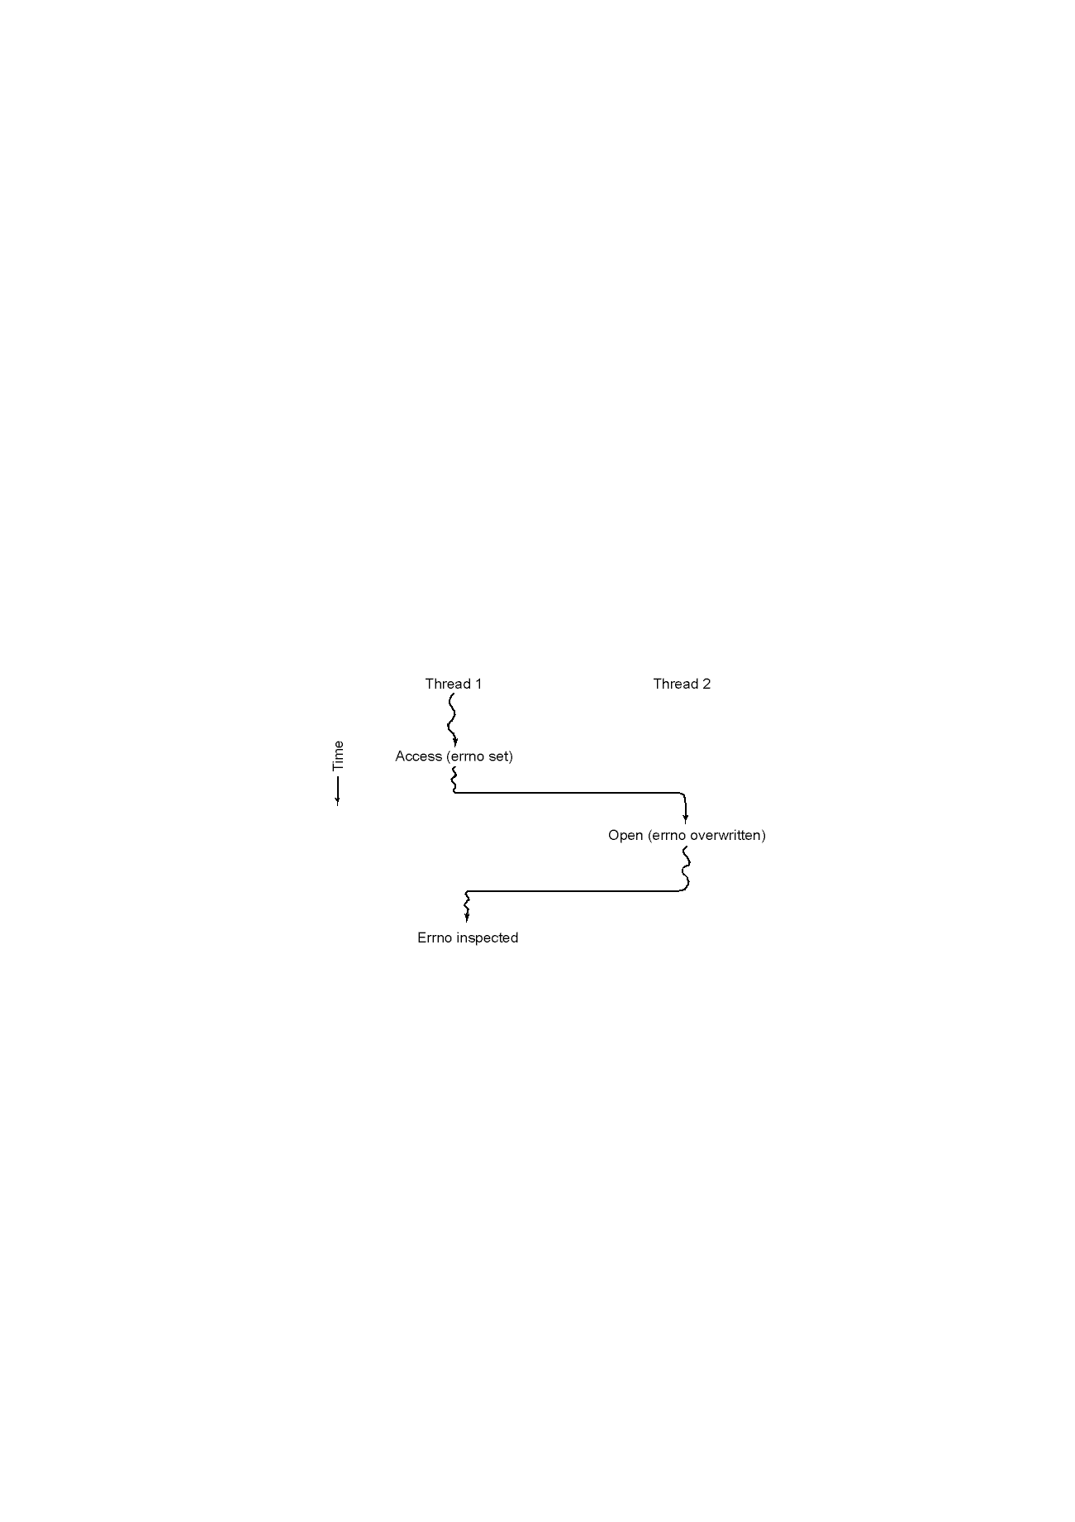
A Challenge: Making Single-Threaded Code Multithreaded
Figure 2-19. Conflicts between threads over the use of a global variable
----A Solution:全面禁止全局变量

Slide 41
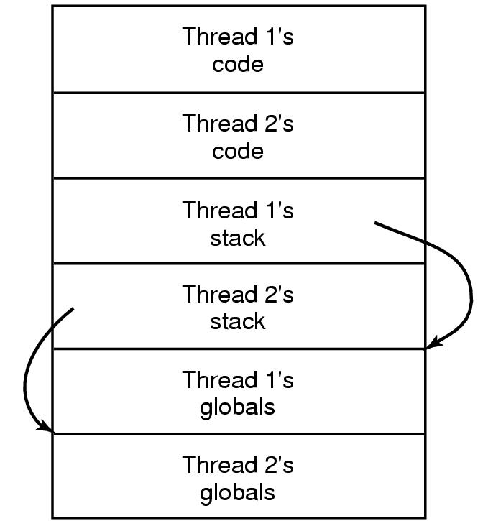
Making Single-Threaded Code Multithreaded (2) --A solution: Private Global Variables
实现方法:
(1)为全局变量分配内存,并将它作为额外的参数转送给线程中的每个过程.
(2)引入新的库过程,以便创建、设置和读取这些线程范围的全局变量。
create_global(“bufptr”);
set_global(“bufptr”,&buf);
bufptr=read_global(“bufptr”);
(3)如果库过程不是可重入的，可能需要重新定义系统调用，并重写库
Figure 2-20. Threads can have private global variables.

Slide 42
Summary(1)
What is process
Process states and model
What information in a process
Process address space
Context switch
What is a thread?
Thread Usage: Examples of using threads
The Classical Thread Model & POSIX Threads
Thread implementations
Pop-Up Threads
Making Single-Threaded Code Multithreaded

Slide 43
Summary(2)
What is thread? Why need threads?
Difference between process and thread
Thread Implementations and their tradeoffs
User-level
Kernel-level
Hybrid
Service activation
Pop-up threads
Making Single-Threaded Code Multithreaded
Next lecture: Scheduling

Slide 44
After this lecture…
44
Reading assignment: chapter 2
Start next week with Chapter 2.4
Homework:
P98-P99: 1,10,11,15，16,
Notes:
44
To conclude, welcome to the course, start reading chapter 1, and think about Resources, operating systems, and what is wrong with them.
Visit our Web site.
See if you can use the webboard.

